Slide 1

Data Communication and Computer Network BLM3051
Dr. Öğr. Üyesi Furkan ÇAKMAK

Slide 2

Lecture Information Form - Weekly Subjects
BLM3051
Data Communication and Computer Network - 12
Hafta | Tarih | Konular
1 | 20.02.2024 | Introduction to Data Communication Standards Used on Data Communication, Architectural models
2 | 27.02.2024 | OSI Reference Model , Layers and Their Functions, Signaling and Signal Encoding
3 | 05.03.2024 | Parallel and Serial Transmission, Communication Media and Their Technical Specs., Multiplexing (TDM, FDM)
4 | 12.03.2024 | Error Detection and Error Correction Techniques, Data Link Control Techniques, Flow Control
5 | 19.03.2024 | Asynchronous and Synchronous Data Link Protocols (BSC, HDLC)
6 | 26.03.2024 | LAN Technologies Continued, IEEE 802.4, 802.5, 802.11
7 | 02.04.2024 | Connectionless and Connection Oriented Services, Switching
8 | 09.04.2024 | Tatil – Ramazan Bayramı Arifesi
9 | 16.04.2024 | 1. Ara Sınav
10 | 23.04.2024 | Tatil – 23 Nisan Ulusal Egemenlik ve Çocuk Bayramı
11 | 30.04.2024 | Static and Dynamic Routing, Congestion in the Network Layer, Its Causes and Solutions
12 | 07.05.2024 | IP (Internetworking Protocol), ICMP, BOOTP, DHCP
13 | 14.05.2024 | 2. Ara Sınav
14 | 21.05.2024 | UDP (User Datagram Protocol), TCP (Transmisson Control Protocol)
Dr. Öğr. Üyesi Furkan ÇAKMAK

Slide 3
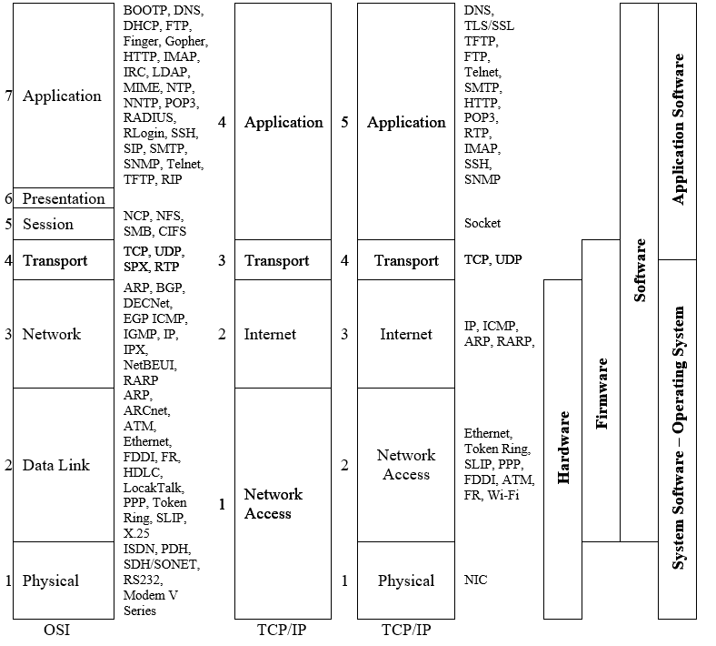
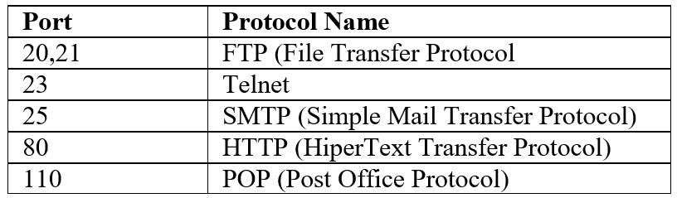
IP (Internetworking Protocol)
BLM3051
Data Communication and Computer Network - 12
TCP/IP: 4-5 katman
Sockets
Transport Layer
TCP (Transmission Control Protocol)
UDP (User Datagram Protocol)
Package: Data with address info
Datagram: Packet that complies with the structure defined by IP
Dr. Öğr. Üyesi Furkan ÇAKMAK

Slide 4
IP (Internetworking Protocol) – Internet Layer
BLM3051
Data Communication and Computer Network - 12
Connectionless Protocol
No ACK
No error handling
Left to other layers
So, IP is also described as an unreliable protocol.
Basic Tasks of IP
Defining datagrams
Adding address info to datagrams
Transferring data between the transport layer and network access layers
Routing of datagrams
Fragmentation of datagrams and Re-assembling of them.
Packets consist of 4 bytes addresses.
Ex: 193.140.4.1
Dr. Öğr. Üyesi Furkan ÇAKMAK

Slide 5
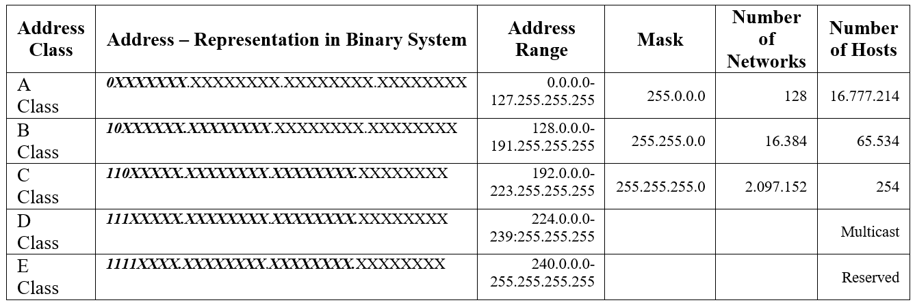

IP (Internetworking Protocol) – IPv4
BLM3051
Data Communication and Computer Network - 12
Host Addresses:
11111111 -> Broadcast
00000000 -> Network Address
254 address left
Subnet
Let's say a company has 35 terminals in Istanbul and 40 terminals in Ankara.
Total 75 terminals.
Is a class C address enough?
Is a class C address too much?
C Class IP Subnet Mask:
255.255.255.192
2 x Network Address
62 ($2^{6})$ x Host Address
Does the number of hosts decrease using subnet?
252 (2 subnet x 126 address/subnet)
248 (4 subnet x 62 address/subnet)
240 (8 subnet x 30 address/subnet)
Dr. Öğr. Üyesi Furkan ÇAKMAK

Slide 6
IP (Internetworking Protocol) – Special IP Addresses and NAT(Network Address Translation)
BLM3051
Data Communication and Computer Network - 12
Special Purpose IP Address
192.168.0.0/16
(255.255.0.0)
10.0.0.0/8
172.16.0.0/12
172.31.0.0/12
192.168.0.0/24
192.168.255.0/24
127.0.0.0
NAT(Network Address Translation)
Dr. Öğr. Üyesi Furkan ÇAKMAK

Slide 7
Thank you for your listening.
BLM3051
Data Communication and Computer Network - 12
Dr. Öğr. Üyesi Furkan ÇAKMAK

